Slide 1

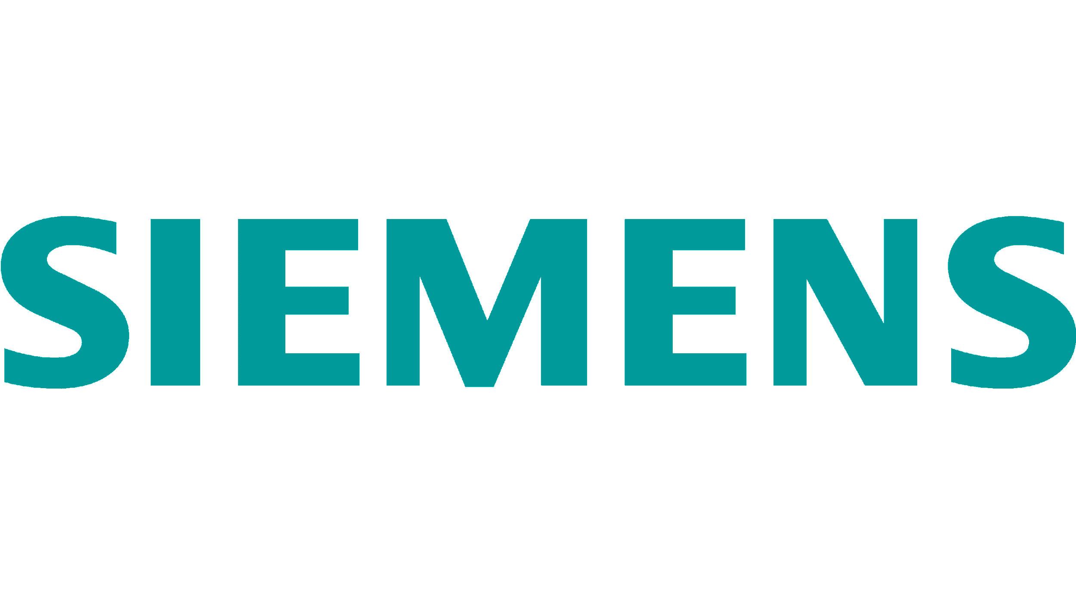
HYBRID SIMULATION APPLICATION-SPECIFIC DEEP LEARNING ACCELERATOR
UNDER SUPERVISION OF:
PROF. DR. WATHEQ ELKHARASHI
DR. MOHAMED ABD EL SALAM
ENG. TASNEEM AWAAD
TEAM MEMBERS:
AHMAD OSSAMA AHMAD 18P6575
AHMED AMR AHMED 18P5837
DANIEL TAREK LEWIS 18P1185
MOSTAFA MOHAMMAD SHAMS 18P6781
SHEHAB MOHAMED IBRAHIM 18P7213
YUSUF SAMEH FAWZI 18P1399

Slide 2
Agenda
Introduction
Background
Related Work
Methodology
Case Study
Results
Demo
Conclusion
Future Work
Introduction
Background
Related Work
Methodology
Case Study
Results
Conclusion

Slide 3
Introduction
Introduction
Background
Related Work
Methodology
Case Study
Results
Conclusion

Slide 4
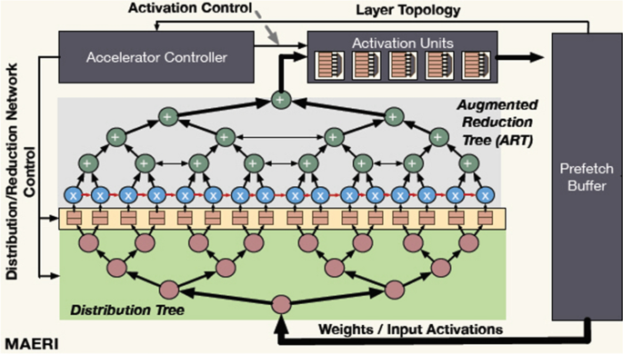
Application-Specific Deep Learning Accelerator (ASDLA)
Hardware Acceleration
Deep Neural Networks (DNN)
ASDLA Configuration
Size of layers
Weights
Biases
Introduction
Background
Related Work
Methodology
Case Study
Results
Conclusion
Notes:
Deep neural networks high complexity computation, energy consumption, costs and memory bandwidth
need to speed up training
Application Specific Deep Learning Accelerator allows the user to choose
Depth
Size of layers
Weights
Biases
According to training the model and datasets based on application need
Lately, Many companies focused on DNN acceleration using chips
As DNN has rapid development in many configurations and architectures so DNN models as RTL or microprocessors aw chips is declining so focus is more on simulation as it is Hard DNN with to capture with RTL

Slide 5
ASDLA Technology
Accelerators vary in their customization for the problem at hand
Desired Application
CPU/GPU
Application-specific Deep Learning Accelerator
AI Accelerator
Introduction
Background
Related Work
Methodology
Case Study
Results
Conclusion
Notes:
Deep neural networks high complexity computation, energy consumption, costs and memory bandwidth
need to speed up training
Application Specific Deep Learning Accelerator allows the user to choose
Depth
Size of layers
Weights
Biases
According to training the model and datasets based on application need
Lately, Many companies focused on DNN acceleration using chips
As DNN has rapid development in many configurations and architectures so DNN models as RTL or microprocessors aw chips is declining so focus is more on simulation as it is Hard DNN with to capture with RTL

Slide 6
Project Objectives
Automatic generation of Application-Specific Deep Learning Accelerator, that can be leveraged with Siemens Virtual Platforms (VP). The tool is capable of:
Building and Training a CNN model (e.g., Lenet-5) from scratch using a specific dataset (e.g., MNIST).
Wrapping the Trained CNN model as a SystemC Model to connect with Virtual Platforms
Supporting both Standard and customized CNN architectures
Verifying the functionality & validity of the model through a SystemC testbench framework (Block level Testing before integration w/VPs)
Introduction
Background
Related Work
Methodology
Case Study
Results
Conclusion

Slide 7
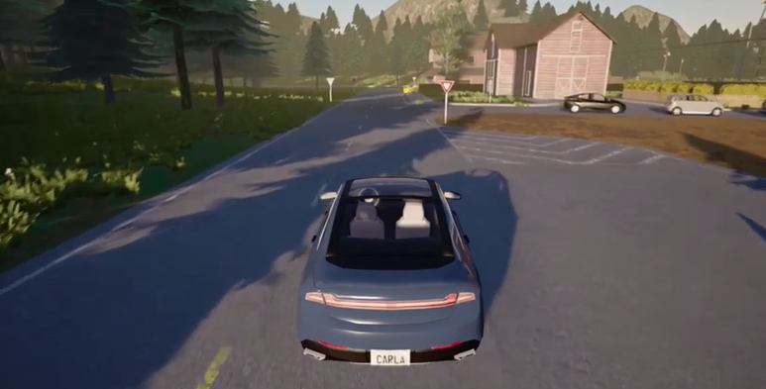

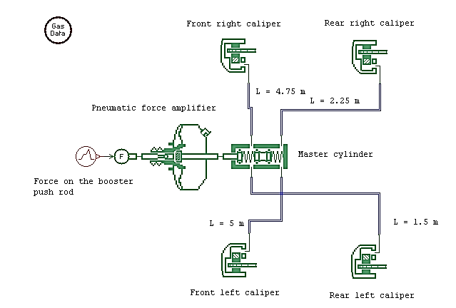
User-specified
DNN model
DNN code generation Framework
Virtual Platform
(COMPUTE)
AI Agent
(Think)
Send RGB Camera Sensor
Data
Gateway
Interconnect
Trained
DNN Model
Gateway
Gateway
Gateway
Get Inference Results
Simcenter
Prescan
(SENSE)
Simcenter
Amesim
(ACT)
7
Introduction
Background
Related Work
Methodology
Case Study
Results
Conclusion

Slide 8
Background
Introduction
Background
Related Work
Methodology
Case Study
Results
Conclusion

Slide 9
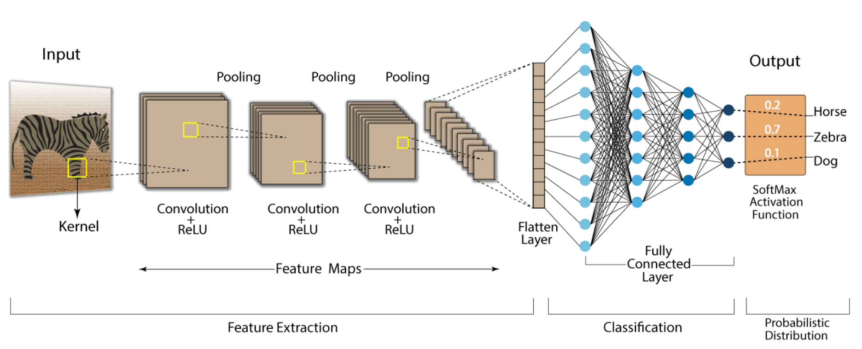
Convolutional Neural Networks
Introduction
Background
Related Work
Methodology
Case Study
Results
Conclusion
Notes:
Neural networks and deep learning are closely related concepts. A neural network is a type of machine learning algorithm modeled structured as human brain, composed of layers of interconnected "neurons" which process and transmit information.
deep learning is a technique for implementing neural networks with a large number of layers.
deep learning can be defined in many ways, a very simple definition would be that it's a branch of machine learning in which the models (typically neural networks) are graphed like "deep" structures with multiple layers. Deep learning is used to learn features & patterns that best represent data. It works in a hierarchical way: the top layers learn high-level generic features such as edges, and the low-level layers learn more data specific features. The process of deep learning can be applied to various applications including image classification, text classification, speech recognition, and predicting time series data.
We will focus on CNNs reduces high dimensionality of images without losing its information

Slide 10
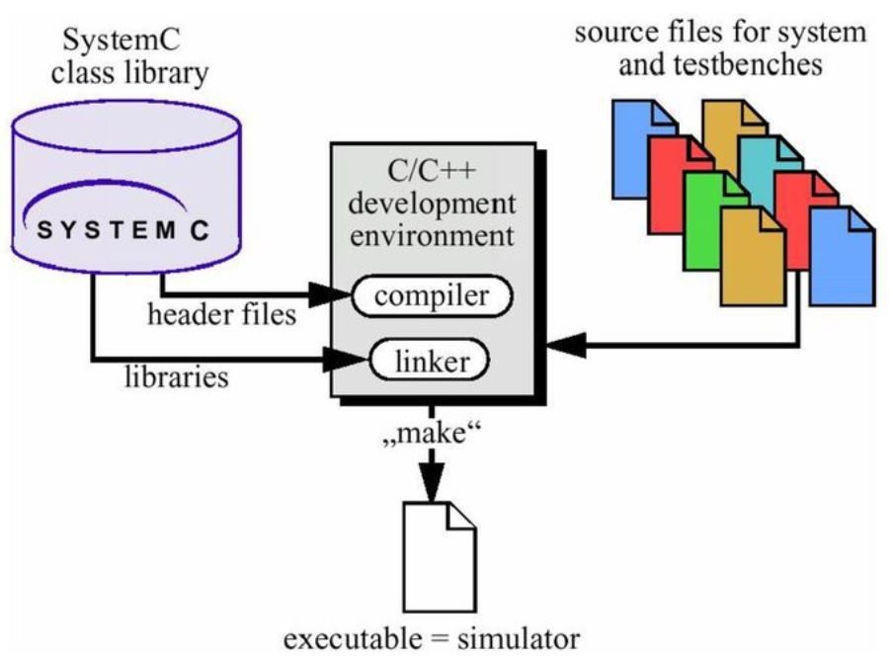
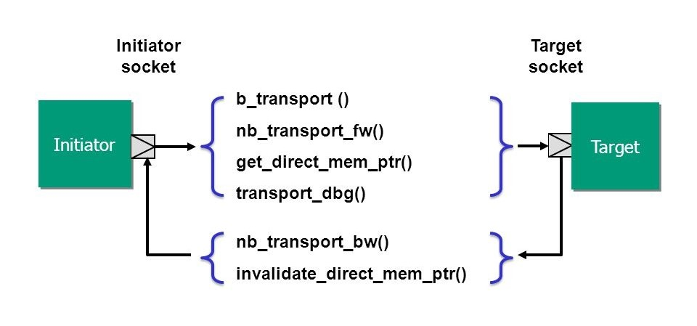
SystemC
What is SystemC?
Extension of C++ to Support HW Modeling
Reactivity, Concurrency, Parallelism, HW Signals
What is Transaction Level Modeling (TLM)?
From Signal Level to Transaction Level
Sockets establish a connection between the initiator & target of transactions.
Initiator socket is used to initiate & send transactions to the target.
Target socket is used to accept & process transactions sent by the initiator.
Transactions are in the form of Generic Payloads
Introduction
Background
Related Work
Methodology
Case Study
Results
Conclusion
Notes:
SystemC is a set of C++ classes and macros which provide an event-driven simulation interface can be used to effectively create hardware architectures and system design. You can use SystemC and standard C++ development tools to create a system-level model, quickly simulate to validate and optimize the design. SystemC allows designers to continue to use the familiar C++ language and development tools. Why not just use C++, SystemC provides the concept of concurrency. For example, consider a digital system that includes two independent processes: a counter and a timer. In C++, one would have to manually create two separate threads of execution and use a synchronization mechanism. With SystemC, the designer can use the provided classes, such as "sc_thread" and "sc_event", to model the two processes as separate threads of execution and use built-in mechanisms to synchronize them. This makes the modeling and simulation of concurrent systems much simpler and more efficient in SystemC.

Slide 11
Related Work
Introduction
Background
Related Work
Methodology
Case Study
Results
Conclusion

Slide 12
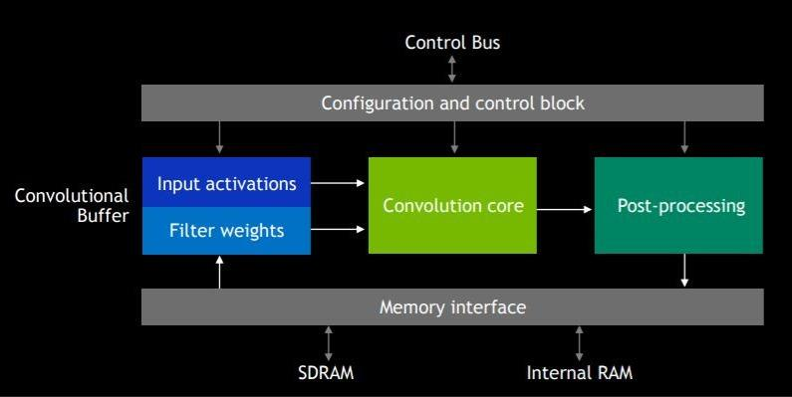
NVIDIA Deep Learning Accelerator (NVDLA)
Introduction
Background
Related Work
Methodology
Case Study
Results
Conclusion
Notes:
NVDLA Overview: NVDLA is an open-source deep learning accelerator architecture developed by NVIDIA. It is designed to efficiently accelerate deep learning inference on various hardware platforms, including GPUs, CPUs, and dedicated AI accelerators.
Key Features:
Scalability: NVDLA supports a wide range of network sizes and complexities, making it suitable for different deployment scenarios.
Configurability: It offers a highly modular architecture that allows users to customize the design based on their specific requirements.
Efficiency: NVDLA optimizes the performance by efficiently utilizing available hardware resources while minimizing power consumption.
Flexibility: It supports a broad range of neural network models and frameworks, enabling developers to work with their preferred tools.
Input Activations and Filter weight -> User inputs through GUI Convolution core -> to out PyTorch scripts Finally, Post-processing corresponds to our wrapping in SystemC
Hybrid Simulation ASDLA: Hybrid Simulation ASDLA (Accelerated Simulation-Driven Layout and Analysis) is an approach that combines traditional electronic design automation (EDA) tools with deep learning acceleration using NVDLA. This hybrid approach leverages the power of AI to enhance and expedite the chip design process.
Benefits of Hybrid Simulation ASDLA:
Faster Design Exploration: By leveraging NVDLA's acceleration capabilities, designers can quickly simulate and analyze different design variations, allowing for faster exploration of potential solutions.
Improved Accuracy: The combination of traditional EDA tools and deep learning enables more accurate predictions and analysis of complex designs.
Enhanced Design Optimization: Hybrid simulation ASDLA can identify design flaws, optimize power consumption, and improve performance by efficiently leveraging the capabilities of NVDLA.
Use Cases:
Chip Design: Hybrid simulation ASDLA can be applied to various stages of chip design, including floorplanning, placement, routing, and analysis, to improve overall efficiency and productivity.
Performance Analysis: By using NVDLA's deep learning capabilities, designers can analyze and predict the performance of complex systems, such as high-speed communication networks or advanced AI architectures.
Power Optimization: NVDLA can help identify power-hungry components within a design, allowing designers to optimize power consumption and improve energy efficiency.
Remember to provide more details, examples, and visuals to support your presentation and make it engaging for your audience.

Slide 13
Methodology
Introduction
Background
Related Work
Methodology
Case Study
Results
Conclusion

Slide 14
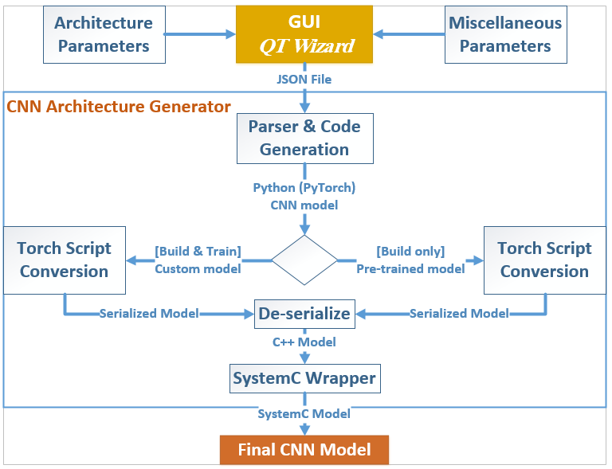
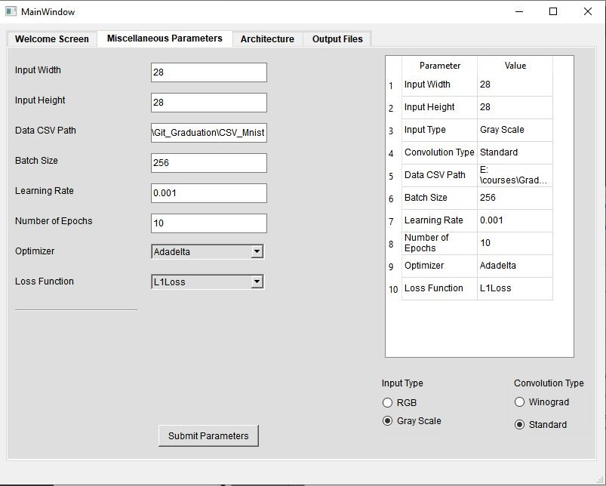
Overview
Introduction
Background
Related Work
Methodology
Case Study
Results
Conclusion

Slide 15
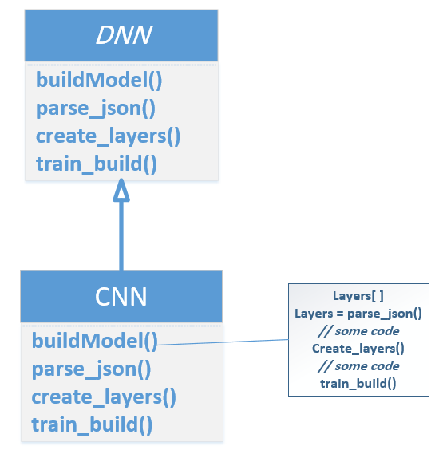
Architecture (Template Design Pattern)
Defines the structure of a Neural Network
Promotes code reuse
Consistent structure across variations
Reduces code duplication
Promotes modularity & maintainable codebase
Introduction
Background
Related Work
Methodology
Case Study
Results
Conclusion

Slide 16
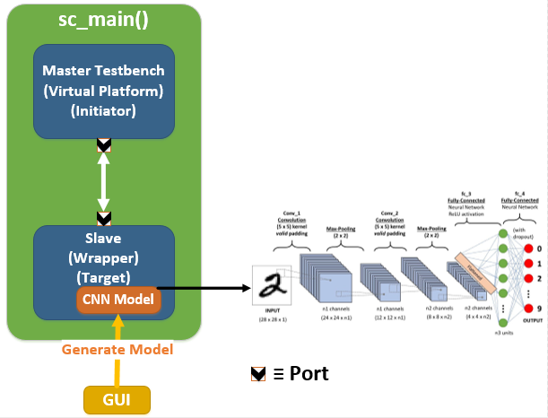
Verification Environment
Establish a connection between master & slave
A TLM generic payload is used for bidirectional communication between master & slave
Master sends payload (test image) to slave
Slave performs inference on payload
Slave sends output predictions back to master
Introduction
Background
Related Work
Methodology
Case Study
Results
Conclusion
Notes:
The default transaction type for the socket classes, is tlm_generic_payload

Slide 17
Case Study
Introduction
Background
Related Work
Methodology
Case Study
Results
Conclusion

Slide 18
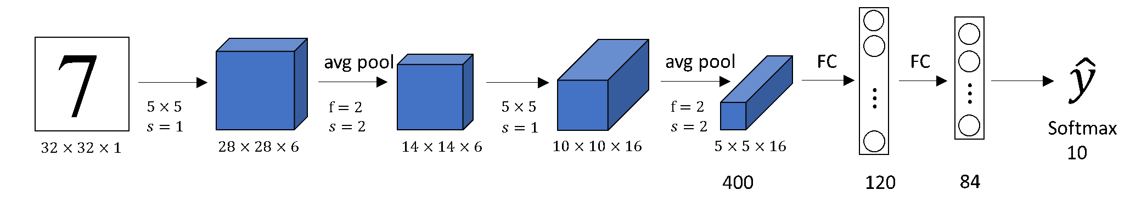
Lenet-5 Case Study
1st Convolutional Neural Network introduced
60,000 Trainable Parameters
Trained on MNIST Dataset
Output is 10 classes
Introduction
Background
Related Work
Methodology
Case Study
Results
Conclusion

Slide 19
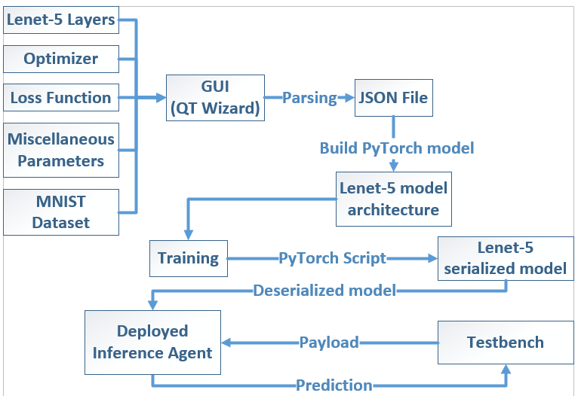
Lenet-5 Case Study
Introduction
Background
Related Work
Methodology
Case Study
Results
Conclusion

Slide 20
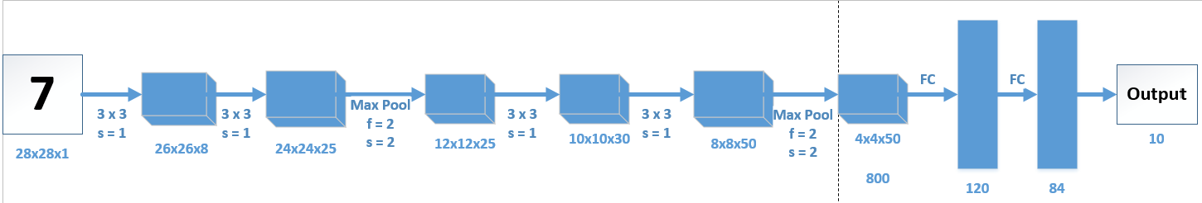
Customized Architecture Case Study
129,369 Trainable Parameters
Trained & tested on MNIST Dataset
Output is 10 classes
Introduction
Background
Related Work
Methodology
Case Study
Results
Conclusion

Slide 21
Results
Introduction
Background
Related Work
Methodology
Case Study
Results
Conclusion

Slide 22
Results
We used our tool to generate both Lenet-5 variants and compared between their results
This shows the added value of our generation framework in exploring different design alternatives and generating the code of an ASDLA for each configuration
Introduction
Background
Related Work
Methodology
Case Study
Results
Conclusion

Slide 23
Platform Specifications
Processor:
Intel(R) Core(TM) i7-7660U CPU @ 2.50GHz
Installed RAM:
16.0 GB
System Type:
64-bit operating system, x64-based processor
Storage drive:
512.0 GB SSD
Introduction
Background
Related Work
Methodology
Case Study
Results
Conclusion

Slide 24
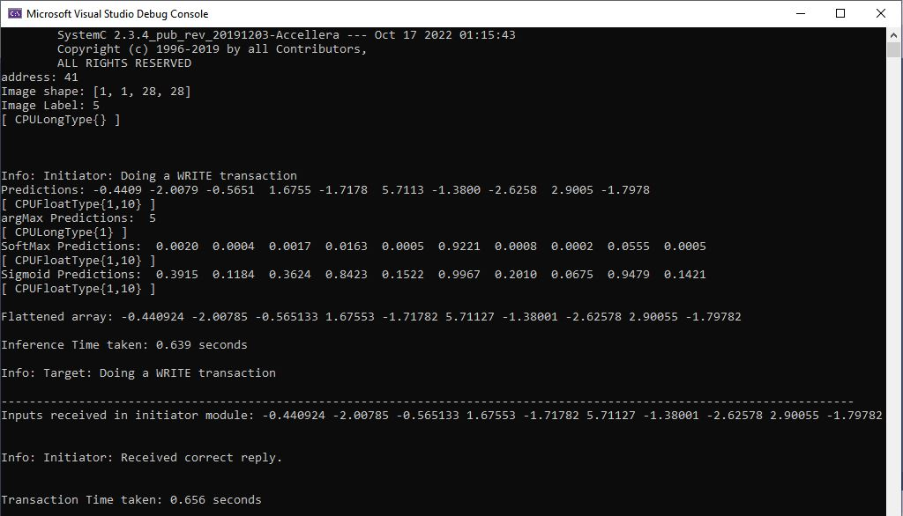
Lenet-5 Model Results
Transaction Time: 0.656 sec
Inference Time: 0.639 sec
Communication: 0.017 sec
Verification Accuracy: 98.2% (same as in Python)
Introduction
Background
Related Work
Methodology
Case Study
Results
Conclusion

Slide 25
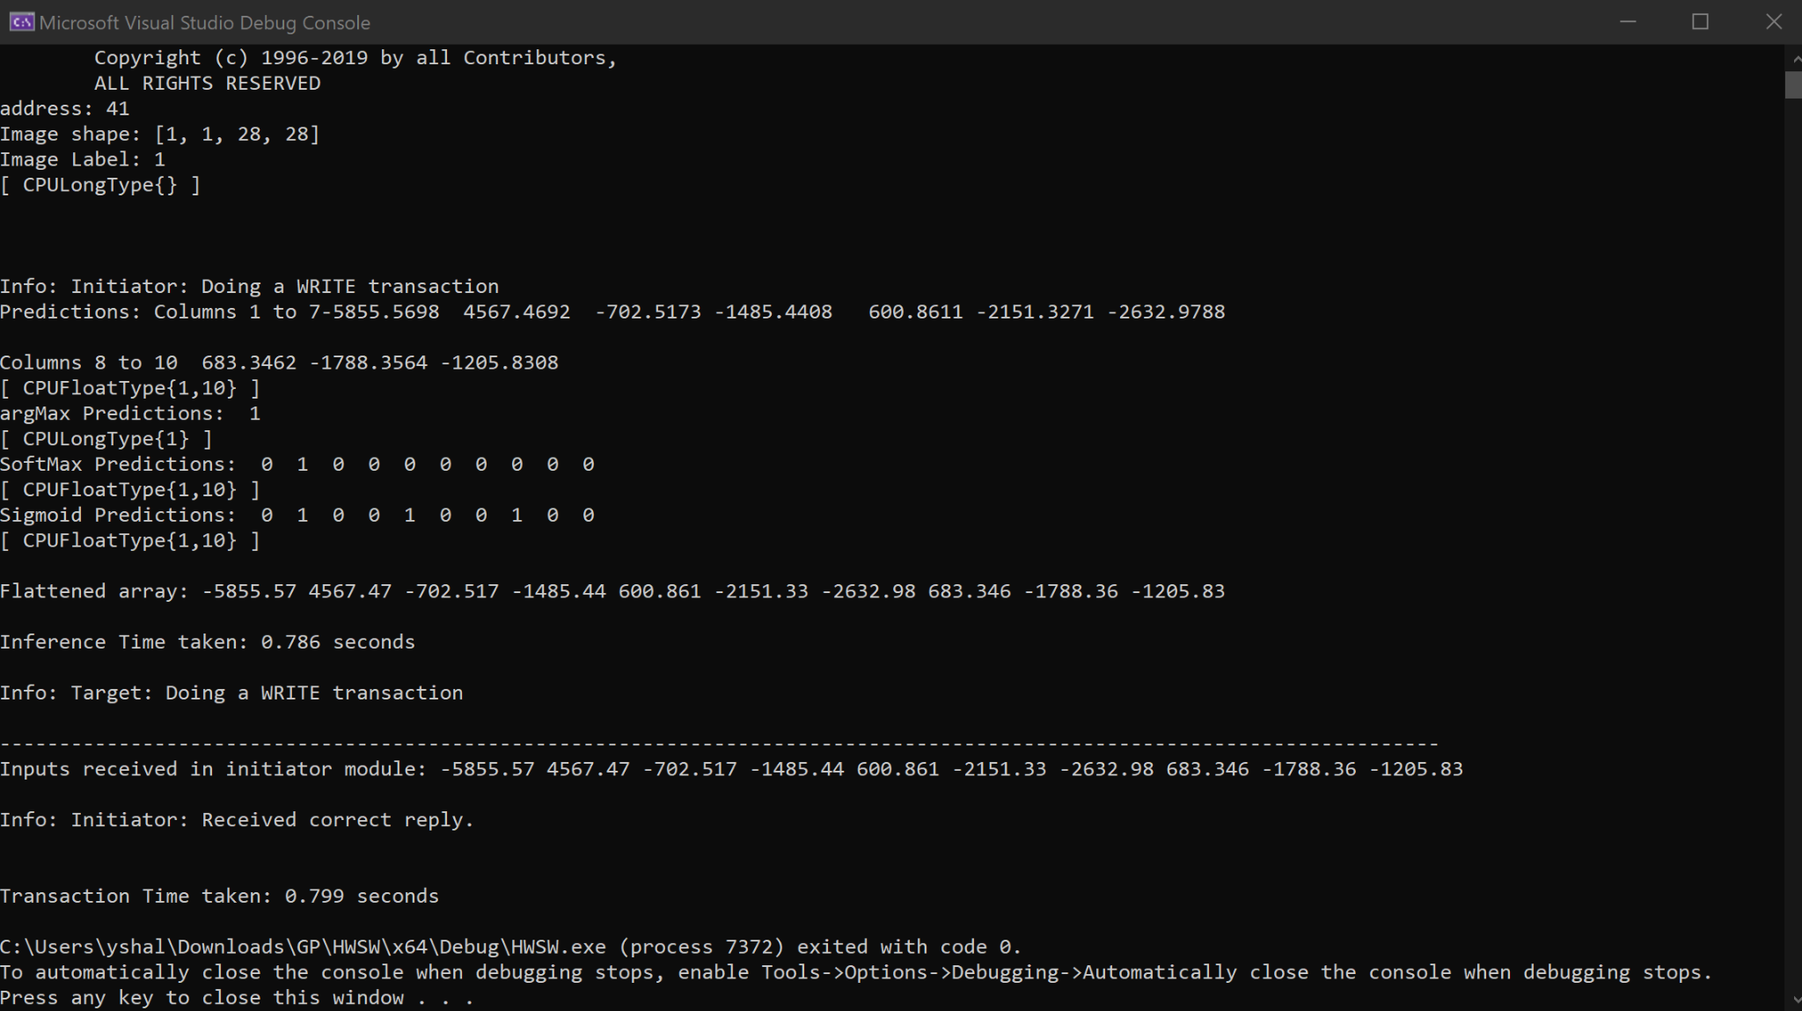
Customized Model Results
Transaction Time: 0.799 sec
Inference Time: 0.786 sec
Communication: 0.013 sec
Verification Accuracy: 95.48% (same as in Python)
Introduction
Background
Related Work
Methodology
Case Study
Results
Conclusion

Slide 26
Conclusion
The tool automates the generation of CNN models with developer-level accuracy
The models are generated in a reasonable time frame.
The tool converts Python models into C++ using PyTorch script conversion
The converted models are wrapped in SystemC code
Through generating CNN models in Python & wrapping them in SystemC, the tool can be integrated seamlessly with other applications (e.g., Virtual Platforms)
ASDLAs are essential tools in providing necessary computational power and enabling complex tasks and data analysis
Introduction
Background
Related Work
Methodology
Case Study
Results
Conclusion

Slide 27
Future Work
Integrate the tool with SIEMENS DI SW Virtual platform (e.g., RCAR M3)
Generate more complex DNN architectures
Allow user to infer very deep pre-trained models through GUI
User can choose a defense mechanism and generate it
Introduction
Background
Related Work
Methodology
Case Study
Results
Conclusion
Notes:
digital simulation is used on cameras to do intrusions and distortions for image pixels or put stickers on road signs to deceive drivers that’s why we need defense mechanism for drivers in future

Slide 28
Thank You

